Slide 1
STORY 5
NEVER ENDING LOVE

Slide 2
This story is based on the relatively short life of deceased Fishing Lake resident Delores (Fayant) Lehr as created and narrated by her daughter Marty Morin.
The viewer is not privy to the tragic story behind Delores’ passing, but we soon realize that it is her children’s quest to re-discover their roots and family through the recovery of shared memories and stories that is the main message of this story. While the story might have revolved around a story of trauma, loss, anger, and regret, the storyteller has opted instead to focus on the positive elements of life.

Slide 3
Through photos and shared memories, we see glimpses into the brief life of Delores and how her daughter has chosen to interpret her life in a positive life as one way to adapt to their mother’s loss at very young ages. Moreover, the importance of community for her mother is revealed as we hear that, “her door was always open to those who needed a place to stay.” This statement is illustrative of an ongoing collective orientation despite the relocation of this young Métis woman to an urban setting in her early married years. As the story concludes, we see that Delores’ four children have managed to adapt to a life without their mother, and in spite of their tragic loss early in their lives and their many challenges in the provincial foster care system, they have chosen to adopt an optimistic outlook on life.

Slide 4
Watch the digital st0ry once for initial reactions; watch a second time to gain insight.

Slide 5
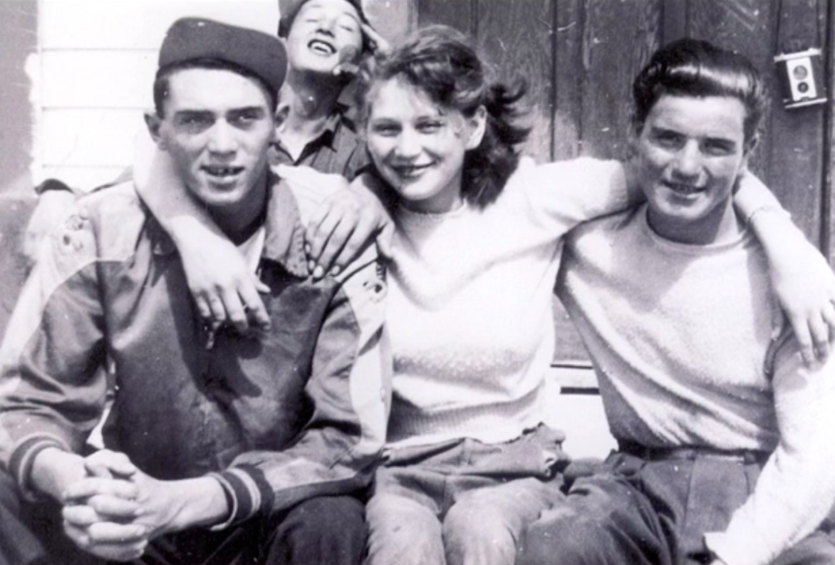

Slide 7
We now invite you to respond to the following questions:

Slide 8
Central Message
What is the central message that comes from Marty’s story?
Double click here to add your answers!

Slide 9
When children are removed from immediate and extended family members, as well as community, what repercussions can result?
Double click here to add your answers!
Double click here to add your answers!
1
3
5
2
4
Double click here to add your answers!
Double click here to add your answers!
Double click here to add your answers!

Slide 10
What is being done today, on a provincial and national level, to ensure the negative outcomes of the Sixties Scoop are not repeated?
2010
Double click here to add your answers!
1960
2025
2000
Double click here to add your answers!
2020
Double click here to add your answers!

Slide 11
Reflect on the strength and impact of a mother’s love in the early formative years.
How can we employ Indigenous concepts of family and kinship to help encompass a wider sense of community and belongingness?
Double click here to add your answers!

Slide 12
What approaches to life were modelled by Delores that allowed her children to survive and thrive?
Double click here to add your answers!
Double click here to add your answers!

Slide 13
When children have been separated from their mothers during the early formative years, what can we do to help support their wish to re-connect?
Step #1
Step #2
Step #3
Step #4
Double click here to add your answers!
Double click here to add your answers!

