Slide 1
STORY 2
NÎCIMOS
(sweetheart in
Cree-Michif)

Slide 2
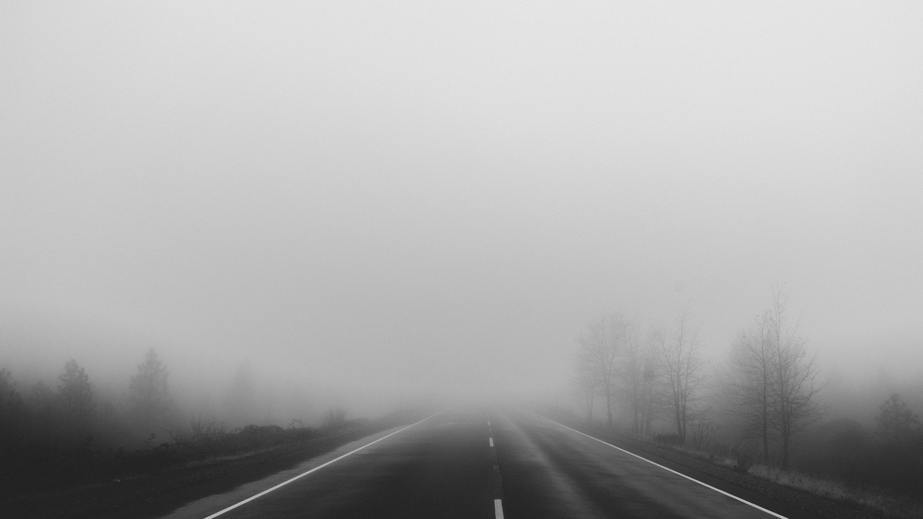
This digital story represents an intergenerational exchange between a long-time settlement resident, (deceased) Irene Calliou, and her grand-daughter Destiny Chalifoux who was 12 years old at the time of the story’s creation.

Slide 3
The video begins with Destiny asking her grandmother how she met Grandpa, and in Irene’s recounting we see how closely aligned the Métis community is to that of nearby Frog Lake First Nations. This life story revolves around the importance of loving connections within a family, and how Métis identity can be viewed as kinship as well as chosen connections, including adoption.
Just as importantly, Irene as the family matriarch sends out a powerful message of what a healthy relationship looks like to her grand-daughter: “He treated me good.” As Irene recalls some of her husband’s many attributes, the viewer is witness to the independent ways of the Métis by way of Allen’s cattle-herding abilities with only his trusty horse and dog at his side.

Slide 4
At the same time, the involvement of the community during times of need, such as branding, and that of celebrating, in this case his marriage to Irene, are also apparent. The passing reference to “Chilly Moss” spending the night in jail is a reflection of how community members take such events in stride as a normal part of life. Above all, in sharing those things most cherished and valued with her grand-daughter including the couple’s favourite song, Irene has passed on a strong set of values and knowledge traditions to the next generation of strong Métis women.

Slide 5
Watch the digital st0ry once for initial reactions; watch a second time to gain insight.

Slide 6
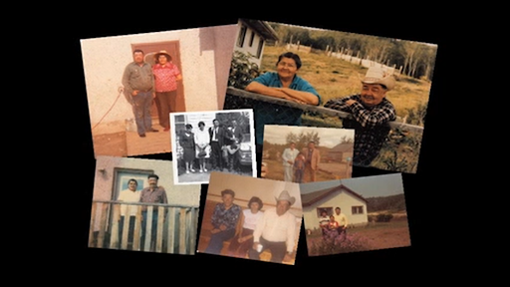

Slide 8
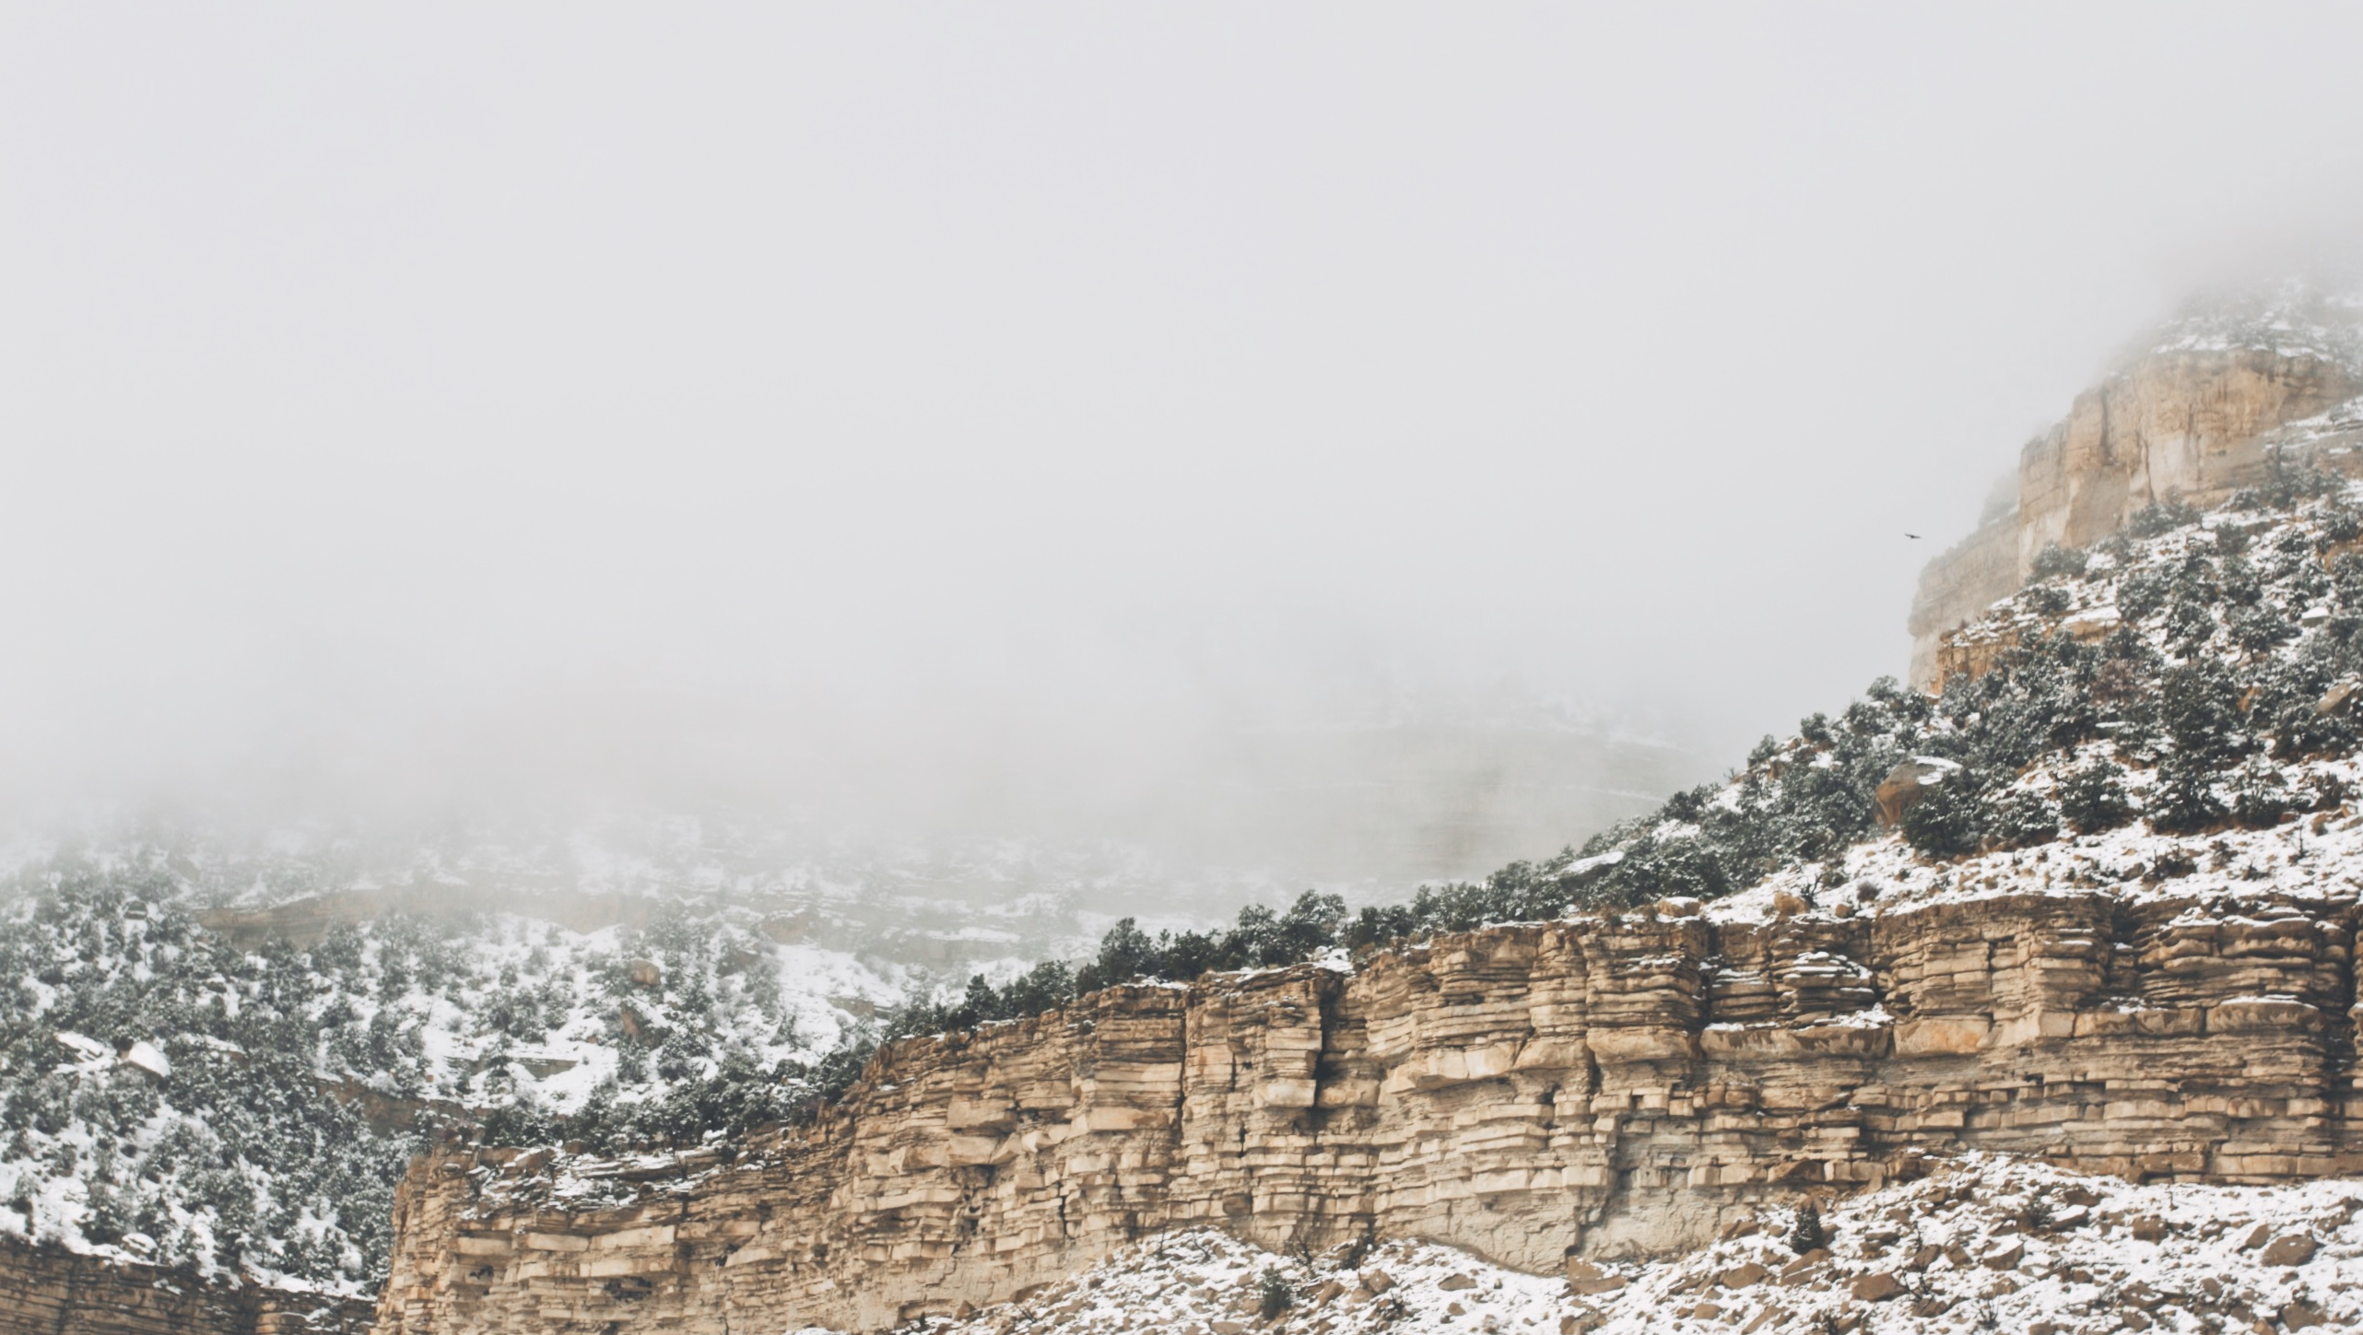
We now invite you to respond to the following questions:

Slide 9
Central Message
What is the central message that comes from Irene and Destiny’s story?
Double click here to add your answers!

Slide 10
The Indigenous perspective on kinship is unique.
What similarities and differences in an Indigenous sense of kinship are portrayed?

Slide 11
Similarities
Differences
Double click here to add your answers!
Double click here to add your answers!
Double click here to add your answers!
Double click here to add your answers!
Double click here to add your answers!
Double click here to add your answers!

Slide 12
Why might older generations of Indigenous people pass on knowledge around healthy relationships to younger generations?
Double click here to add your answers!

Slide 13
Connecting the song to the story, how do the storytellers convey a sense of community and
well-being?
Double click here to add your answers!
02
01
Song
03
04

Slide 14
What values are embedded in Irene and Destiny’s story?
Double click here to add your answers!
Double click here to add your answers!
Double click here to add your answers!
Double click here to add your answers!

